Slide 1

Extracting Structured Data from PDFs to Databases
By:
Prof. Dr. Randy Lin,
Naga Vasikarla,
Aanya Goel.

Slide 2


Project Aim
Automate the extraction of financial tables and integrate them into a database for competitor market analysis.

Slide 3

Existing Methods
Manual Data Entry:
Open PDF files and manually copy and format table data into spreadsheets or databases.
2. AI Tools (e.g., ChatGPT):
Provide table data from PDFs as text to AI tools for extraction.

Slide 4
Limitations:
Data Complexity: Handling highly complex or multi-page tables may result in incomplete or incorrect extraction.
Time-Consuming: Manually copying and formatting data is a slow process, especially for large or multiple PDFs.
Error-Prone: Human errors like typos, misaligned rows, or missed entries can occur during manual transfer.
Limited PDF Integration: General AI tools often lack built-in capabilities to process PDFs directly, necessitating additional tools for extraction.

Slide 5

The project focuses on:
Automating financial table extraction from competitor company financial report PDFs.
Integrating seamlessly with databases, enabling efficient storage, analysis, and competitor market evaluation.
Enhancing accessibility by generating extracted and formatted tables into individual csv files.

Slide 6

Our Approach
Automated Extraction:
Built a system to automatically identify and extract tables from PDF documents.
Organized Data:
Converted the extracted tables into a clean, structured format that is easy to use.
Connected to Database:
Stored the data in a cloud-based system for quick and easy access anytime.

Slide 7

Challenges We Encountered
Accurate Table Extraction:
Handling diverse table formats and layouts in PDFs, such as merged cells and irregular structures.
Data Formatting and Integration:
Converting extracted data into a clean, structured format and ensuring seamless storage in the database.

Slide 8
Testing
Input file 1:146 pages with 141 tables.
Input file 2: 96 pages with 40 tables.
Input file 3: 113 pages with 60 tables.
Metrics:
Accuracy: Measures whether the table content has been extracted.
Formatting: Measures whether the tables are formatted exactly as in the original.

Slide 9
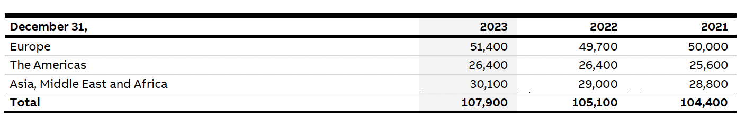
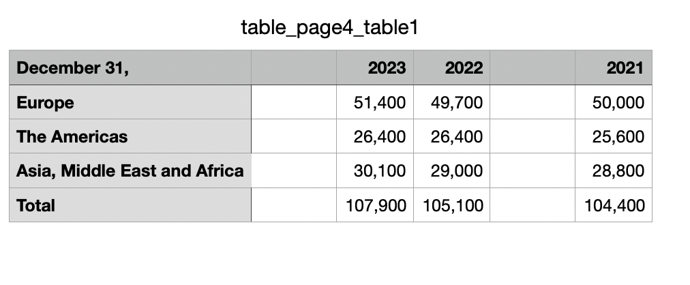
Test case 1:
Testing Small Sentences in Rows or Columns.
Observation: Tables with short, well-aligned content are extracted and formatted correctly.
1 out of 6 columns has behaved different.
Key Success: Data matches original structure.
Accuracy: 100%.
Formatting: 83%.

Slide 10
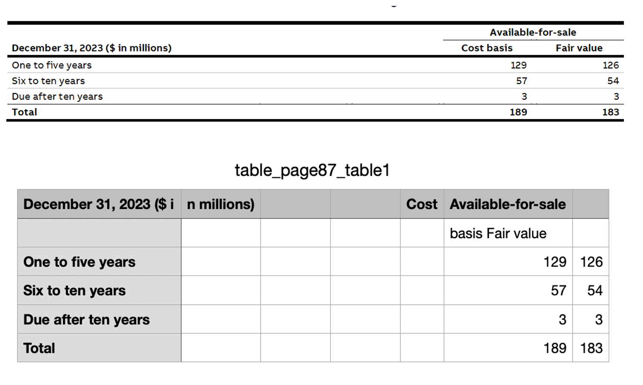
Testing irregular column headers. Observation: Headers spanning multiple columns are split incorrectly. Root Cause: Misalignment during table parsing. Accuracy: 100%. Formatting: 68%.
Test case 2:

Slide 11
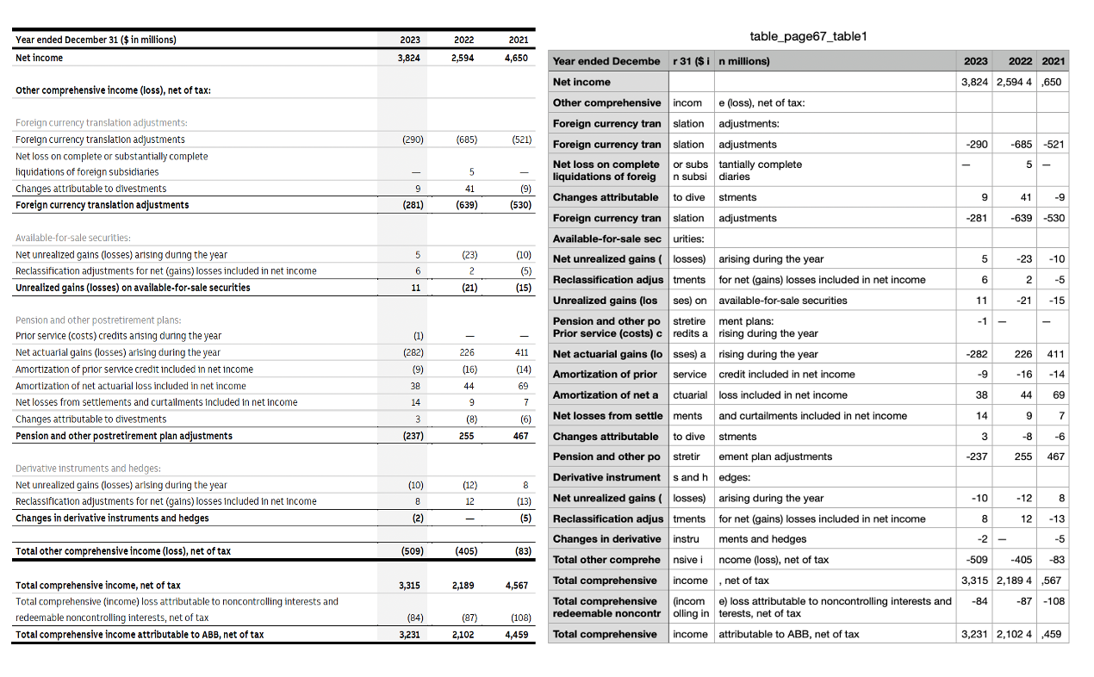
Test case 3:
Testing long sentences:
Observation: Long sentences are divided into multiple columns.
2 out 6 rows have behaved unexpected.
Accuracy: 100%
Efficiency: 66%

Slide 12
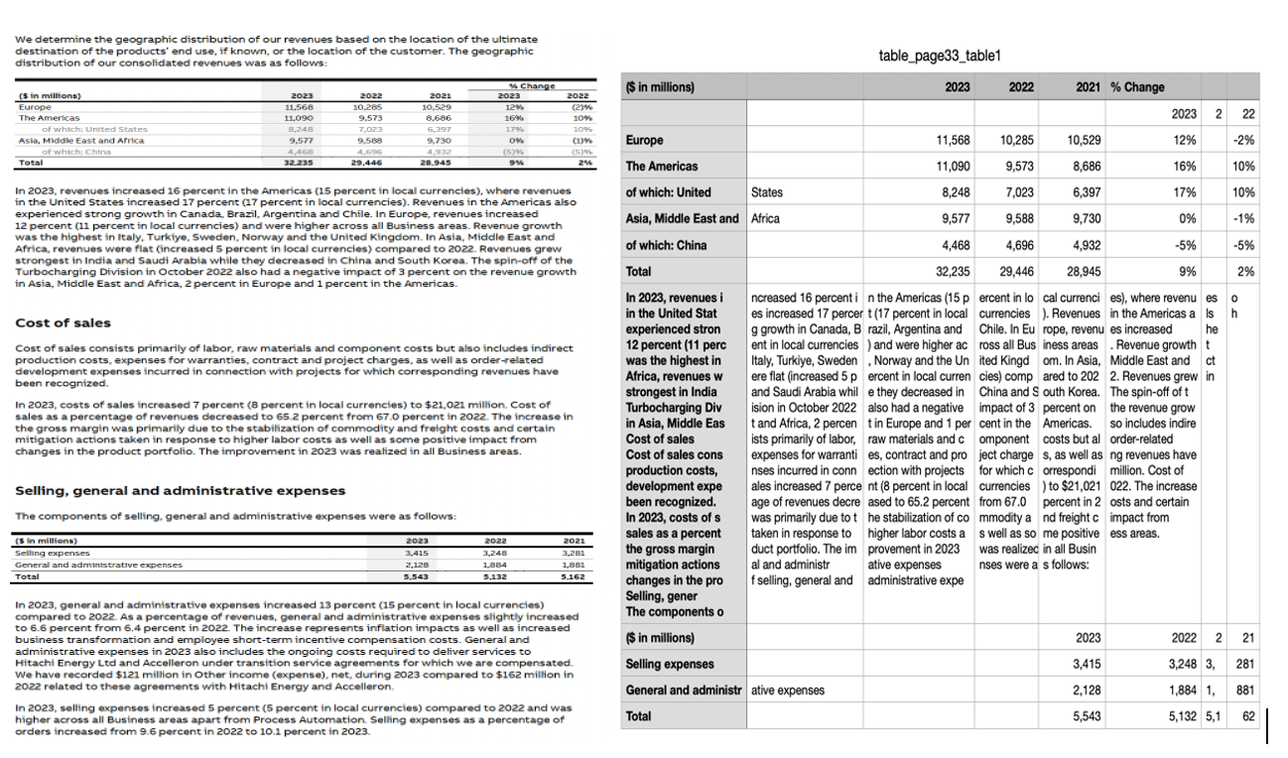
Test case 4:
Testing multiple tables in a page.
Observation: Extracts all tables but includes non-tabular content between them.
6 out of 13 rows in the table, behaved unexpectedly.
Successfully identifies and extracts multiple tables.
Accuracy: 50%.
Formatting: 53%.

Slide 13
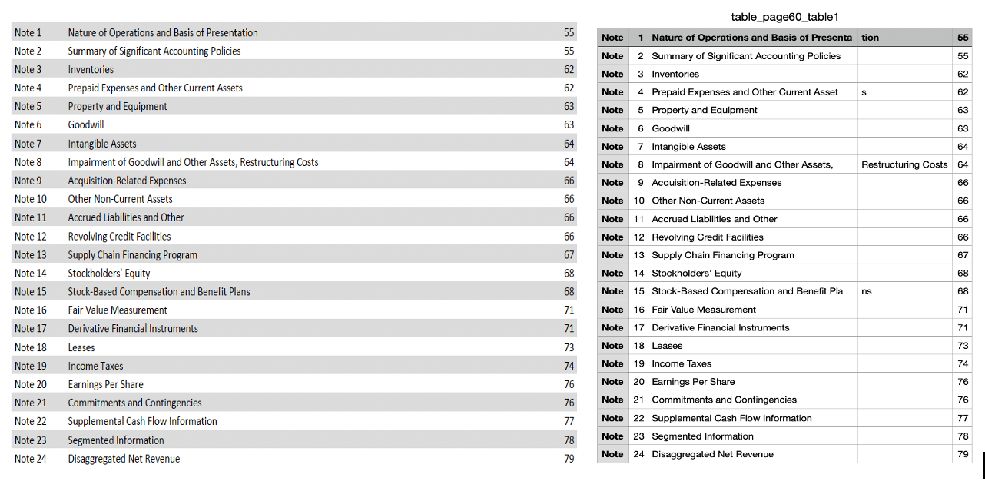
Input file 2 Test case 5:
Testing Small Sentences in Rows or Columns.
Observation: Tables with short, well-aligned content are extracted and formatted correctly.
1 out of 5 columns behaves unexpectedly.
Accuracy : 100%
Formatting: 80%

Slide 14
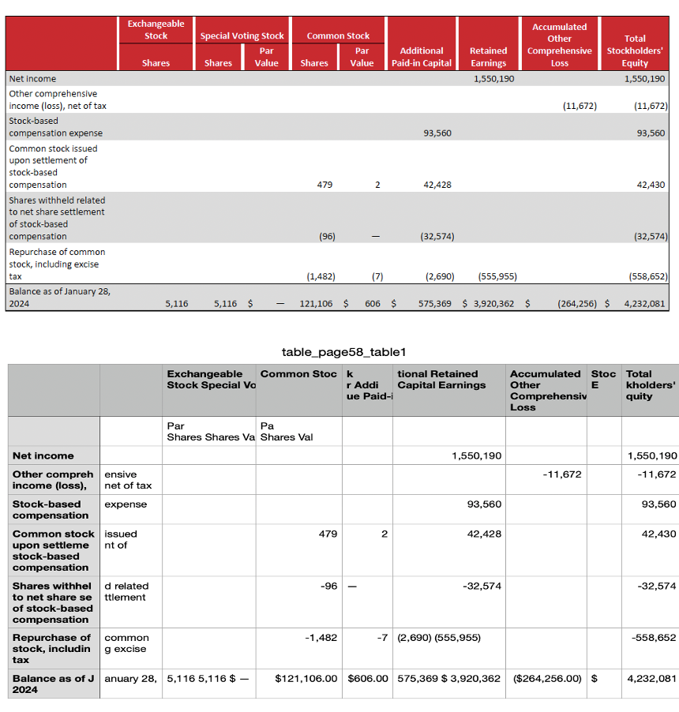
Input file 2 Test case 6:
Testing Irregular Column Headers
Observation:
Headers spanning multiple columns split into extra, unintended columns.
Root Cause:
Misalignment or overlapping boundaries during parsing.
Key Success:
Captures all header data, albeit with formatting errors.
Accuracy: 80%
Formatting: 40%

Slide 15
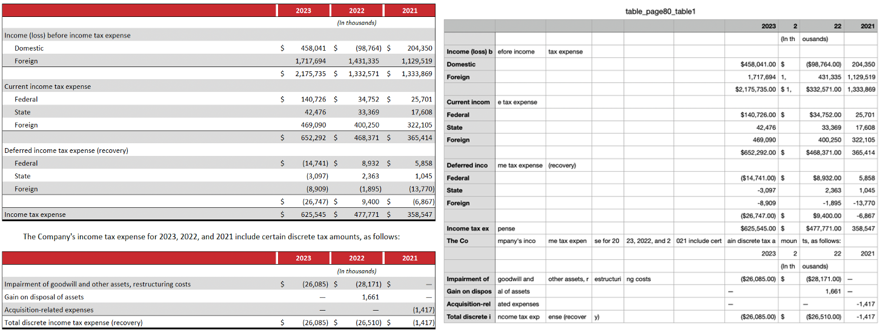
Input file 2 Test case 7:
Testing long sentences and multiple tables in a page together.
Observation: The long sentences have been split into multiple columns.
The text in between the tables has been merged with the tables.
Accuracy: 50%
Formatting: 50%

Slide 16
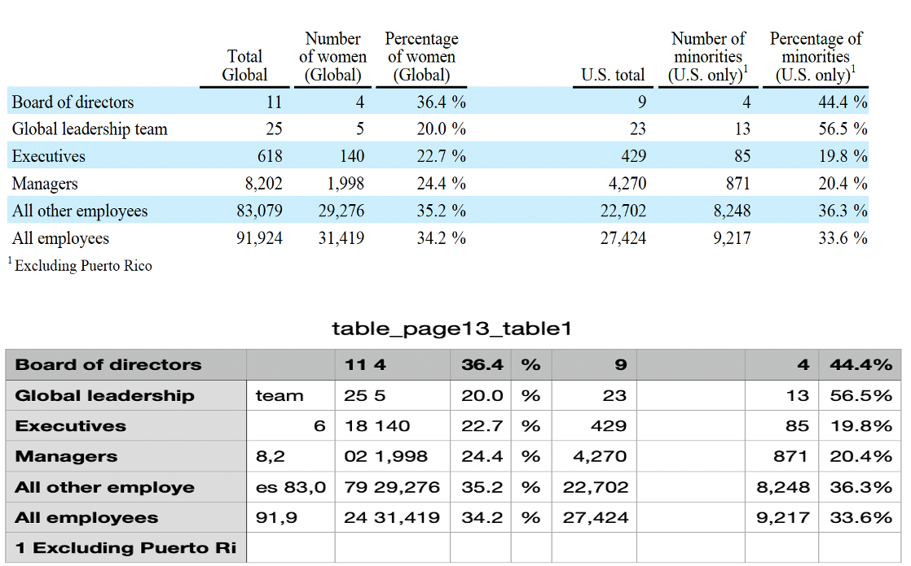
Input file 3 Test case 8:
Testing: Undefined Row Headers
Observation: Missing or malformed row headers are ignored or removed.
Key success: Extracts the rest of the table data accurately.
Accuracy: 87%
Formatting: 82%

Slide 17
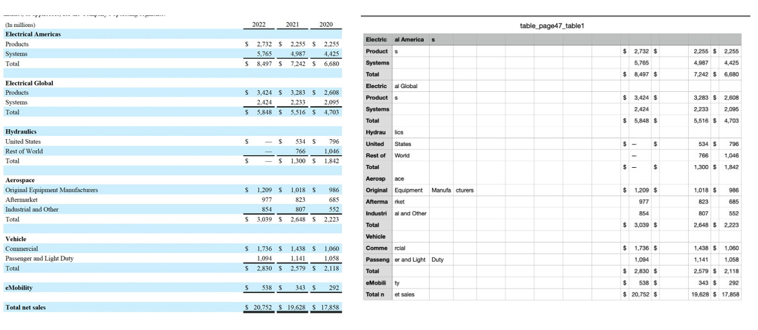
Input file 3
Test case 9:
Testing large tables with long sentences.
Observation: Large tables are extracted correctly, with all content preserved, but long headings are split into multiple columns, causing formatting issues.
1 out of 22 rows has been removed due to poor layout.
Accuracy: 95%
Formatting : 81%

Slide 18
Data Formatting and Integration
Issues Identified:
Heading Misalignment: Long headings in the original PDF table are being split across multiple columns during extraction, disrupting the table structure.
Multiple Tables Identification: Difficulty in accurately distinguishing and extracting multiple tables from a single page.
Possible Causes:
Column Boundary Misinterpretation: The tool might be misreading the layout, treating lengthy headings as separate entries.
Text Wrapping Confusion: Long text in a single cell may be interpreted as spanning multiple columns.

Slide 19
Overall Results
Overall Result
Success: Pages with single tables and simple formatting were extracted and exported accurately.
Issues: Long heading formatting and Pages containing multiple tables encountered challenges in the extraction.
Extraction: Difficulty in correctly identifying table boundaries.
Accuracy: 84%.
Formatting: 67%.

Slide 20
Future Vision
Automated Business Reports:
Enhance table parsing for complex layouts.
Improve handling of irregular headers and content alignment.
Generate reports based on financial tables for quick competitor insights.

Slide 21

Interactive Dashboards
Create visualizations for revenue trends, competitor performance, and regional comparisons.
Use dynamic graphs and charts for user-friendly analytics.

Slide 22
Thank you

